Slide 1
Able to Create Styles of web pages using CSS
(25 hours)
Notes:
Title - The learning outcome
Subtitle - Duration

Slide 2
In this section, we will discuss:
Introduction to CSS
Limitations of CSS
Advantages of CSS
CSS Syntax
Three ways to integrate CSS
Merits and demerits of -external Style Sheets,, Embedded Style Sheets
Notes:
Mention the parent topics one by one. This particular learning outcome has 6 parent topics.

Slide 3
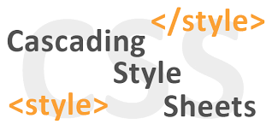
Introduction to CSS
CSS
CSS stands for Cascading Style Sheets.
It is the language for describing the presentation of Web pages, including colours, layout, and fonts, thus making our web pages presentable to the users.
Image Source:
https://encryptedbn0.gstatic.com/images?q=tbn:ANd9GcRrQ6UjtIs5YsI5AKDLxCDPh0KQP10DgI9Tnw&usqp=CAU
Notes:
Left (White Color space):
Title - Parent Topic
Subtitle - Subtopic 1
Body Text - Description in bullets
Right (Grey Color Space):
Body Text - Relevant image (with source)/code snippet
Cascading Style Sheets is a style sheet language used for describing the presentation of a document written in a markup language such as HTML.
Reference:
https://encryptedbn0.gstatic.com/images?q=tbn:ANd9GcRrQ6UjtIs5YsI5AKDLxCDPh0KQP10DgI9Tnw&usqp=CAU

Slide 4
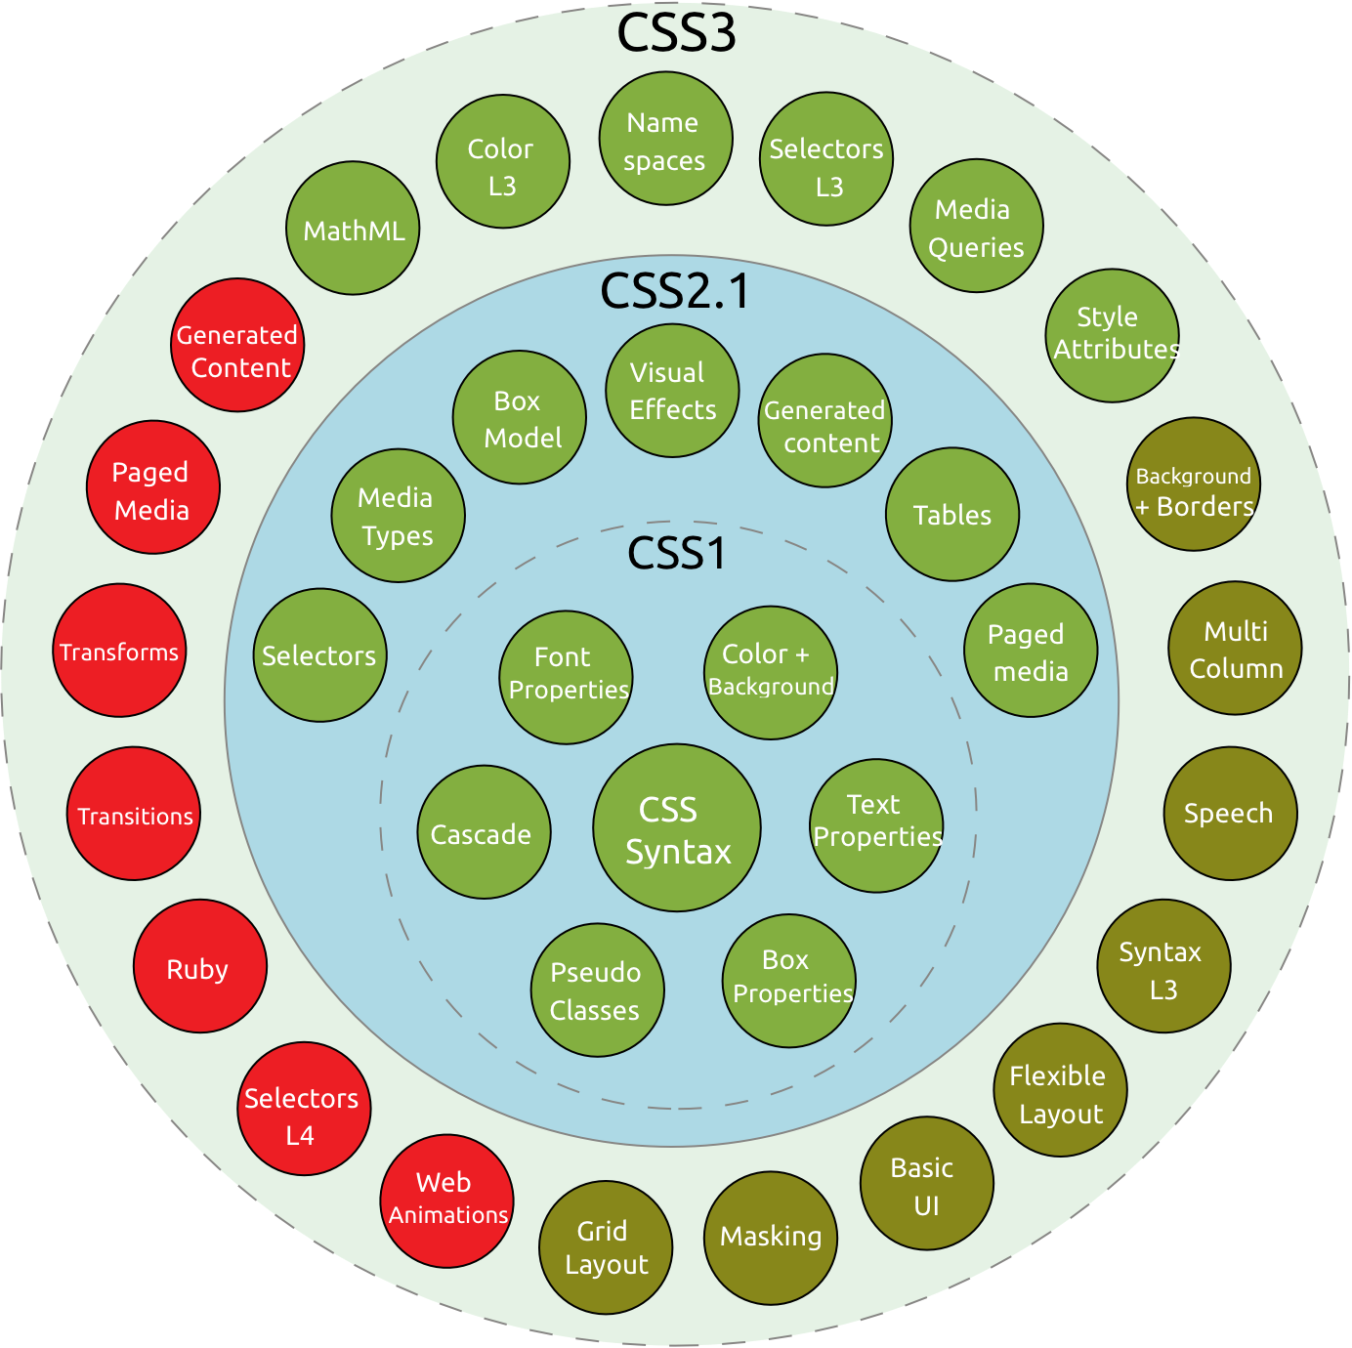
Introduction to CSS
History of CSS
CSS was first proposed by Hakon Wium Lie on October 10, 1994
CSS was proposed in 1994 as a web styling language, to solve some of the problems of Html 4
Image Source::
https://miro.medium.com/max/2768/1*7V_zawxy3_kZbHs2d6NT9w.png
Notes:
This slide talks about the case if we have to divide a subtopic further.
Left (White Color space):
Title - Parent Topic
Subtitle - Subtopic 2
Body Text - Description in bullets
Right (Grey Color Space):
Body Text - Relevant image (with source)/code snippet
CSS (1996) allows the user to select font style and size and change the colour of the text and background.
CSS2 (1998) has capabilities that allows the user to design page layout.
CSS3 (1999) allows the user to create presentations from documents and to select from a wider range of fonts including those from Google and Typecast. Uniquely, CSS3 allows the user to incorporate rounded borders and use multiple columns. CSS3 is considered to be easier to use (when compared to CSS2) because it has different modules
Reference:
https://miro.medium.com/max/2768/1*7V_zawxy3_kZbHs2d6NT9w.png

Slide 5
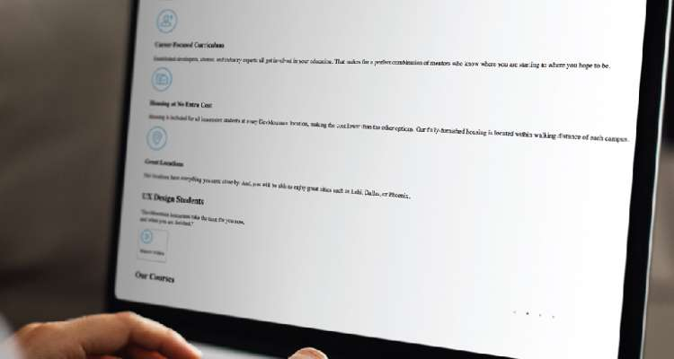

Introduction to CSS
Why CSS?
CSS saves time
Easy Maintenance
Search Engines
Superior styles to HTML
Offline Browsing
Image Source:
https://blog.devmountain.com/what-is-css-and-why-use-it/
Notes:
Left (White Color space):
Title - Parent Topic
Subtitle - Subtopic 3
Body Text - Description in bullets
Right (Grey Color Space):
Body Text - Relevant image (with source)/code snippet
CSS saves time : You can write CSS once and reuse same sheet in multiple HTML pages.
Easy Maintenance : To make a global change simply change the style, and all elements in all the webpages will be updated automatically.
Search Engines : CSS is considered as clean coding technique, which means search engines won’t have to struggle to “read” its content.
Superior styles to HTML : CSS has a much wider array of attributes than HTML, so you can give a far better look to your HTML page in comparison to HTML attributes.
Offline Browsing : CSS can store web applications locally with the help of offline cache. Using of this we can view offline websites.
Reference:
https://blog.devmountain.com/what-is-css-and-why-use-it/

Slide 6
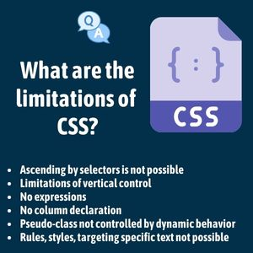
Limitations of CSS
Limitations
Confusion due to many CSS Versions
Cross-Browser Issues
Security Issues
Extra Work for Developers
Image Source:
https://i0.wp.com/www.mocamboo.com/wpcontent/uploads/2021/10/163342618048plc.jpg?fit=300%2C300&ssl=1
Notes:
Left (White Color space):
Title - Parent Topic
Body Text – Subtopic
Body Text - Description in bullets
Right (Grey Color Space):
Body Text - Relevant image (with source)/code snippet
CSS cannot perform any logical operations like if/else or for/while or +/-.
We can not read any files using CSS.
It can not interact with databases.
CSS can not request a web page.
Reference:
https://i0.wp.com/www.mocamboo.com/wpcontent/uploads/2021/10/163342618048plc.jpg?fit=300%2C300&ssl=1

Slide 7
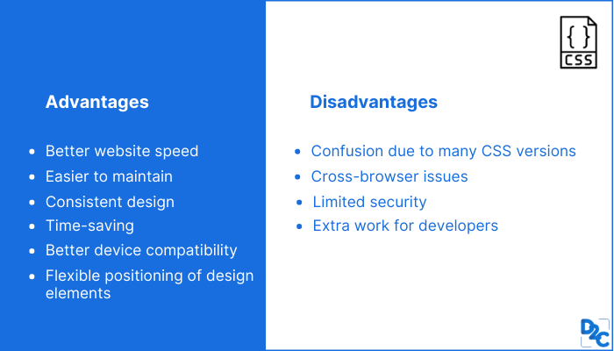
Advantages of CSS
Advantages
CSS saves time
Pages load faster
Superior styles to HTML
Multiple Device Compatibility
Global web standards
Offline Browsing
Platform Independence
Image Source:
https://d8it4huxumps7.cloudfront.net/bites/wp-content/banners/2021/10/616ffee11ce1e_advantages_and_disadvantages_of_css.png
Notes:
Left (White Color space):
Title - Parent Topic
Body Text – Subtopic
Body Text - Description in bullets
Right (Grey Color Space):
Body Text - Relevant image (with source)/code snippet
CSS saves a lot of time.
It helps to make consistent and spontaneous changes.
It improves the loading speed of the page.
CSS has the ability to re-position.
It has better device compatibility.
Reference:
https://d8it4huxumps7.cloudfront.net/bites/wp-content/banners/2021/10/616ffee11ce1e_advantages_and_disadvantages_of_css.png

Slide 8
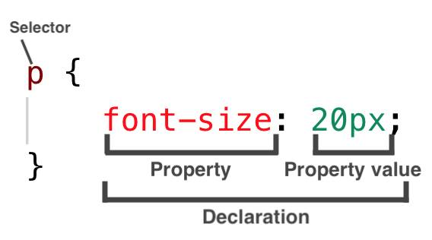
CSS Syntax
Syntax
3 Elements to a CSS Statement
Selector
Property
Value
Image Source:
https://codebrainer.azureedge.net/images/what-is-css-declaration.jpg
Notes:
Left (White Color space):
Title - Parent Topic
Body Text – Subtopic 1
Body Text - Description in bullets
Right (Grey Color Space):
Body Text - Relevant image (with source)/code snippet
Selector: selects the element you want to target
Keys: properties(attributes) like color, font-size, background, width, height, etc
Value: values associated with these properties
There are few basic selectors like tags, id’s, and classes
All forms this key-value pair
Reference:
https://codebrainer.azureedge.net/images/what-is-css-declaration.jpg

Slide 9
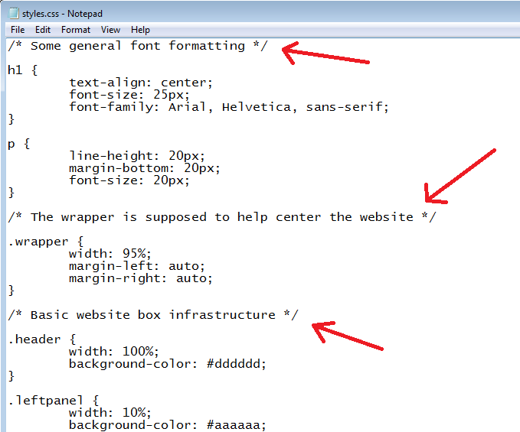
CSS Syntax
CSS Comments
Comments are used to explain the code, and may help when you edit the source code at a later date.​
Comments are ignored by browsers.
Image Source:
https://www.freezenet.ca/wp-content/uploads/2019/03/CSS_9_1.png
Notes:
This slide talks about the case if we have to divide a subtopic further.
Left (White Color space):
Title - Parent Topic
Subtitle - Subtopic 2
Body Text - Description in bullets
Right (Grey Color Space):
Body Text - Relevant image (with source)/code snippet
A CSS comment is used to add explanatory notes to the code or to prevent the browser from interpreting specific parts of the style sheet. By design, comments have no effect on the layout of a document
Reference:
https://www.freezenet.ca/wp-content/uploads/2019/03/CSS_9_1.png

Slide 10

CSS Syntax
White Spaces in CSS
White spaces are special characters that can be an actual space, tab, or newline (carriage return).
These whitespaces are used to construct your stylesheets extra readable.
Image Source:
https://i0.wp.com/css-tricks.com/wp-content/uploads/2011/09/pre.png?resize=290%2C97
Notes:
Left (White Color space):
Title - Parent Topic
Subtitle - Subtopic 3
Body Text - Description in bullets
Right (Grey Color Space):
Body Text - Relevant image (with source)/code snippet
white-space is a CSS property that helps control how whitespace and line breaks within an element's text are treated
Reference:
https://i0.wp.com/css-tricks.com/wp-content/uploads/2011/09/pre.png?resize=290%2C97

Slide 11
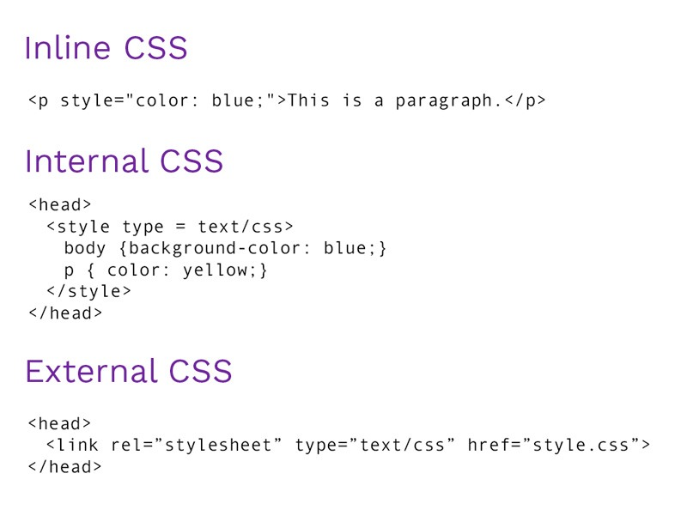
Three ways to integrate CSS
Types of CSS
Inline style sheet
Internal style sheet
External style sheet
Image Source:
https://www.bitdegree.org/learn/inline-css
Notes:
Left (White Color space):
Title - Parent Topic
Body Text – Subtopic 1
Body Text - Description in bullets
Right (Grey Color Space):
Body Text - Relevant image (with source)/code snippet
Internal - Placed right on the page whose interface it will affect.
External - Placed in a separate file.
Inline - Placed inside a tag it will affect.
Reference:
https://www.bitdegree.org/learn/inline-css

Slide 12
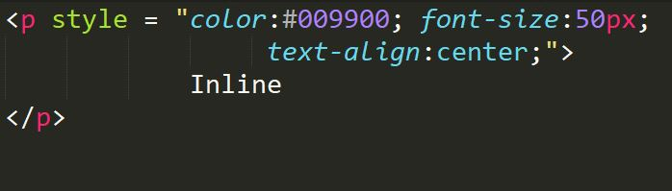
Types of CSS
Inline Style
Inline styles are placed within an HTML element in the code.
Inline styles do not have selectors because its written inside the html element.
Notes:
This slide talks about the case if we have to divide a subtopic further.
Left (White Color space):
Title - Parent Topic
Body Text – Subtopic of Subtopic
Body Text - Description in bullets
Right (Grey Color Space):
Body Text - Relevant image (with source)/code snippet
Inline Styles Sheet
Inline CSS is use with any elements of HTML where it is used on page. Here we use inline css for paragraph,
<p style="color:sienna;margin-left:20px">This is a paragraph.</p>
Reference:

Slide 13
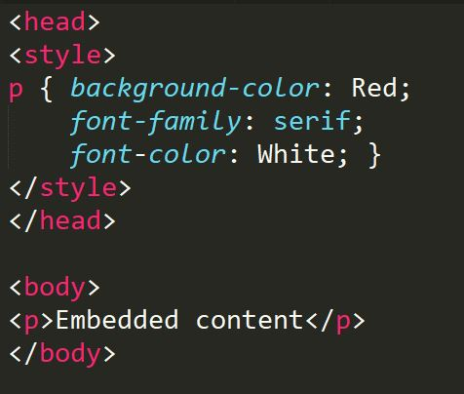
Types of CSS
Internal Style
An internal CSS is used to define a style for a single HTML page.
An internal CSS is defined in the <head> section of an HTML page, within a <style> element.
Notes:
Left (White Color space):
Title - Parent Topic
Body Text –Subtopic of Subtopic
Body Text - Description in bullets
Right (Grey Color Space):
Body Text - Relevant image (with source)/code snippet
Internal Style Sheet
An internal style sheet should be used when a single document has a unique style. Internal styles sheet is defined in the head section of an HTML page, by using the <style> tag
<style>
hr {
color:red;
}
p {
margin-left:20px;
}
</style>
Reference:

Slide 14
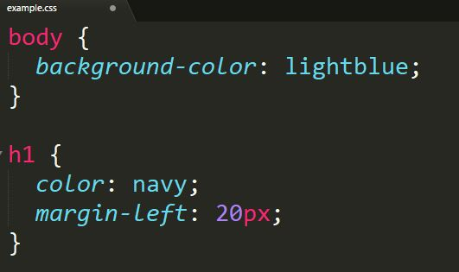
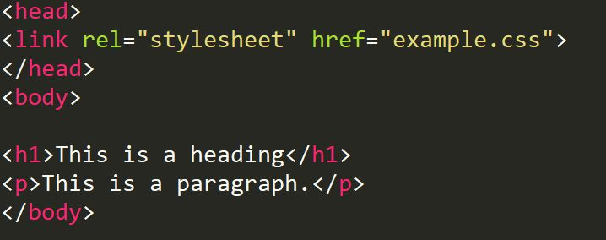
Types of CSS
External Style
External Styles can be reused to apply on more than one page by only linking the style sheet to the web page.
Notes:
Left (White Color space):
Title - Parent Topic
Body Text – Subtopic of Subtopic
Body Text - Description in bullets
Right (Grey Color Space):
Body Text - Relevant image (with source)/code snippet
An external style sheet is a separate CSS file that can be accessed by creating a link within the head section of the webpage.
Multiple webpages can use the same link to access the stylesheet.
The link to an external style sheet is placed within the head section of the page.
External Style Sheet
An external style sheet is ideal when the style is applied to many pages. With an external style sheet, we can change the look of an entire Web site by changing one file. Each page must link to the style sheet using the tag.
<head>
<link rel="stylesheet" type="text/css" href="name of the Css file">
</head>
p{
color:red; //.css file
}
Reference:

Slide 15
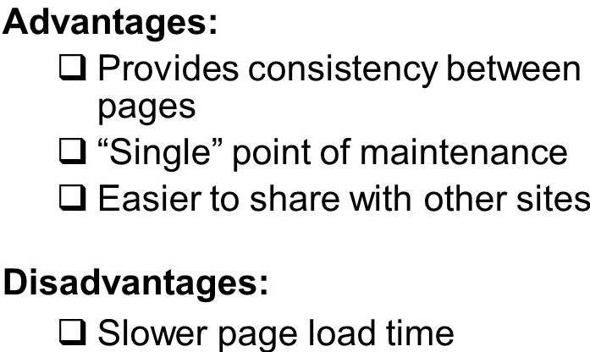
Merits and demerits of - external Style Sheets, Embedded Style Sheets
External Style Sheet
Merits
one change to the style sheet will change all linked pages
consistent look and feel across multiple web pages
Demerits
To render the document, the external style sheet should be loaded.
Image Source:
https://images.slideplayer.com/24/6963284/slides
Notes:
Left (White Color space):
Title - Parent Topic
Body Text – Subtopic 1
Body Text - Description in bullets
Right (Grey Color Space):
Body Text - Relevant image (with source)/code snippet
External Style Sheet
Merits
one change to the style sheet will change all linked pages
you can create classes of styles that can then be used on many different HTML elements
consistent look and feel across multiple web pages
Demerits
Extra download is needed to import documents having style information.
To render the document, the external style sheet should be loaded.
Reference:
https://images.slideplayer.com/24/6963284/slides

Slide 16
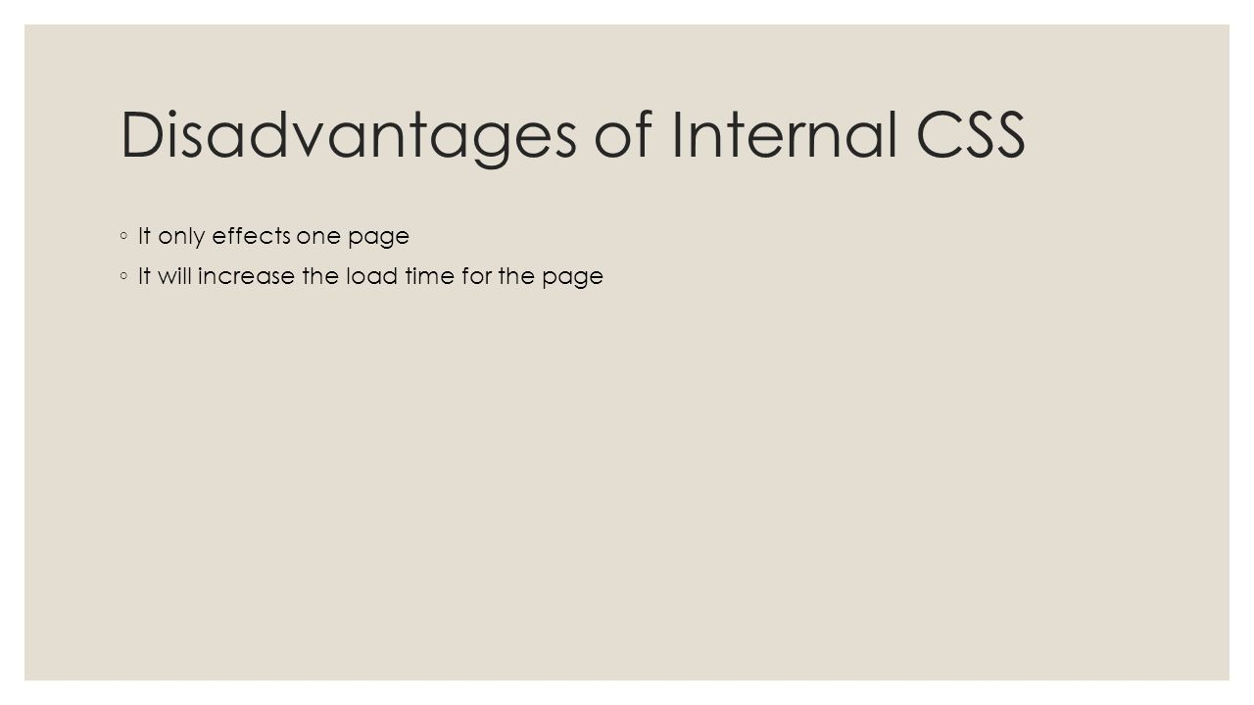
Merits and demerits of - external Style Sheets, Embedded Style Sheets
Embedded Style Sheets
Merits
Multiple tag types can be created in a single document.
Extra download is unnecessary.
Demerits
Multiple documents cannot be controlled.
Image Source:
https://images.slideplayer.com/24/6963284/slides
Notes:
Left (White Color space):
Title - Parent Topic
Body Text – Subtopic 2
Body Text - Description in bullets
Right (Grey Color Space):
Body Text - Relevant image (with source)/code snippet
Embedded/Internal Style Sheet
Merits
Multiple tag types can be created in a single document.
Styles, in complex situations, can be applied by using Selector and Grouping methods.
Extra download is unnecessary.
Demerits
Multiple documents cannot be controlled.
Reference:
https://images.slideplayer.com/24/6963284/slides

